Slide 1
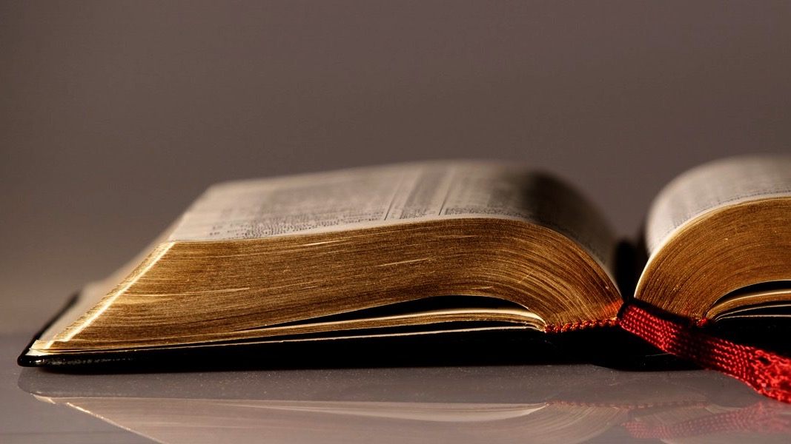
Welcome to
Our Sunday School
We’ll start at 9:07
visit OurSundaySchool.com for more about our class

Slide 2
Philemon, week 10 (pages 24–31)

Slide 3
Philemon 1:17–20
So if you consider me a partner, welcome him as you would me. And if he has wronged you in any way, or owes you anything, charge that to my account. I, Paul, write this with my own hand: I will repay it—not to mention to you that you owe me even your very self. Yes, brother, may I benefit from you in the Lord; refresh my heart in Christ.

Slide 4
Dr. Douglas J. Moo
The central development in verses 8–16 that prepares for verses 17–22 is that Onesimus has become a believer.

Slide 5
Dr. Douglas J. Moo
This now impacts the way that Paul, and more importantly Philemon, will respond to him.

Slide 6
Philemon 1:17–20 (the request)
So if you consider me a partner, welcome him as you would me. And if he has wronged you in any way, or owes you anything, charge that to my account. I, Paul, write this with my own hand: I will repay it—not to mention to you that you owe me even your very self. Yes, brother, may I benefit from you in the Lord; refresh my heart in Christ.

Slide 7
Philemon 1:17–20 (the reality)
So if you consider me a partner, welcome him as you would me. And if he has wronged you in any way, or owes you anything, charge that to my account. I, Paul, write this with my own hand: I will repay it—not to mention to you that you owe me even your very self. Yes, brother, may I benefit from you in the Lord; refresh my heart in Christ.

Slide 8
Philemon 1:17–20 (the hope)
So if you consider me a partner, welcome him as you would me. And if he has wronged you in any way, or owes you anything, charge that to my account. I, Paul, write this with my own hand: I will repay it—not to mention to you that you owe me even your very self. Yes, brother, may I benefit from you in the Lord; refresh my heart in Christ.

Slide 9
Philemon, week 10 (pages 24–31)

Slide 10
Dr. Douglas J. Moo
It is not even clear that Onesimus has done anything wrong…. [Paul] simply assumes the reality of the situation for the sake of argument.

Slide 11
Dr. James D. G. Dunn
It neatly serves the purpose of taking for granted Philemon’s view that Onesimus was guilty of serious misdemeanor, without wholly conceding that Philemon’s judgment was entirely correct

Slide 12
Philemon, week 10 (pages 24–31)

Slide 13
Romans 15:7
Therefore welcome one another, just as Christ also welcomed you, to the glory of God.

Slide 14
Philemon, week 10 (pages 24–31)

Slide 15
Dr. Richard Melick
Paul was prepared to assume financial obligations in order to teach and live by spiritual truths

Slide 16
Philemon, week 10 (pages 24–31)

Slide 17
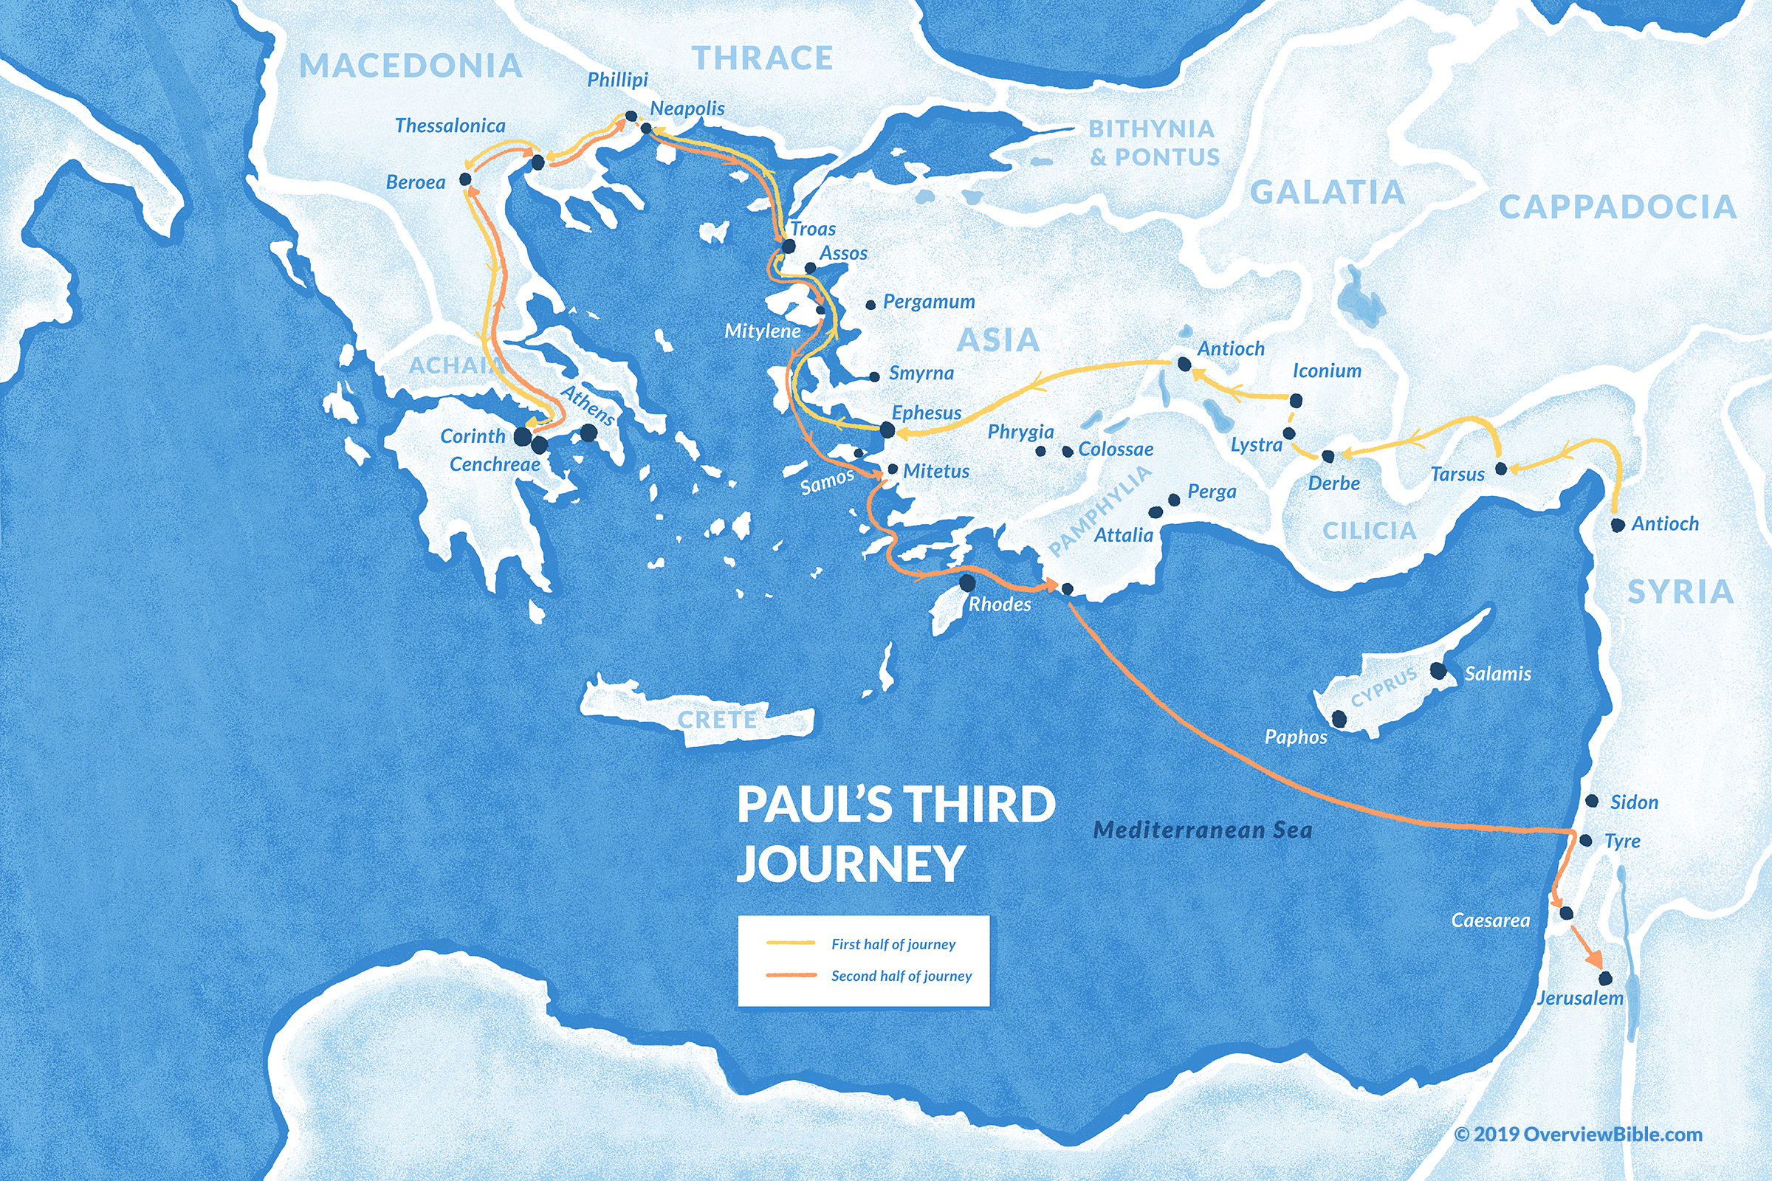

Slide 18
Philemon, week 10 (pages 24–31)

Slide 19
ChatGPT
Philemon owes his spiritual life to Paul’s ministry, reminding us of the interdependence of believers

Slide 20
Philemon, week 10 (pages 24–31)

Slide 21
Dr. A. T. Robertson
A wish about the future

Slide 22
Philemon, week 10 (pages 24–31)

Slide 23
Dr. Douglas J. Moo
The fellowship that is created among those who have faith in Christ (v. 6) brings with it obligations to one another

Slide 24
Dr. N. T. Wright
[Here is] the radical application of the doctrine of justification to everyday living. No Christian has a right to refuse a welcome to one whom God has welcomed.

Slide 25
Dr. N. T. Wright
Faith in Christ, the basis of justification, is the basis also of koinonia. Justification by faith must result in fellowship by faith.

Slide 26
Dr. R. Scott Pace & Dr. Daniel L. Akin
All of us who live under the lordship of King Jesus must never forget who we once were. All of us were once like Onesimus,

Slide 27
Dr. R. Scott Pace & Dr. Daniel L. Akin
runaway slaves (sinners) from our rightful owner (God). But someone stepped in on our behalf, pled our cases, and even offered to pay our debts.

Slide 28
Dr. R. Scott Pace & Dr. Daniel L. Akin
Those who have been reconciled to God through Christ (2 Cor 5:20-21) should be ever ready to do the same for others who have offended or wounded them.

Slide 29
Dr. R. Scott Pace & Dr. Daniel L. Akin
It may initially sting, but joy will surely follow…. We must never forget this: we will never forgive anyone as much as God in Christ has already forgiven us.

Slide 30
Prayer time
Write down your prayer requests (on the Weekly Update or in the comments)
Lean in, engage, and pray for someone not with you
Be out of this room by 9:50
Go worship

